Slide 1
Lesson 4:
Fundamentals of Twitter Bootstrap – Part 3

Slide 2
forms
Bootstrap Forms
Bootstrap's Default Settings
  Form controls automatically receive some global styling with Bootstrap:
  All textual <input>, <textarea>, and <select> elements with class .form- control have a width of 100%.

Slide 3
forms
Bootstrap form layouts
  Bootstrap provides three types of form layouts:
    Vertical form (this is default), Horizontal form, Inline form
  Standard rules for all three form layouts:
    Wrap labels and form controls in <div class="form-group"> (needed for optimum spacing)
    Add class .form-control to all textual <input>, <textarea>, and <select> elements

Slide 4
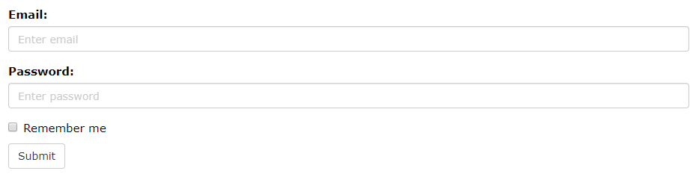
forms
Bootstrap Vertical Form (default)

Slide 5
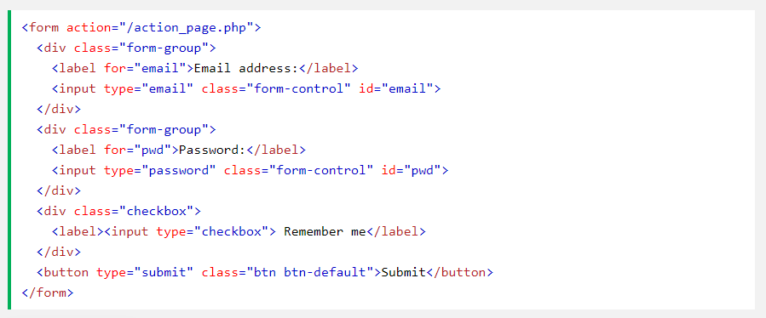
forms
Bootstrap Vertical Form (default)

Slide 6
forms
Inline Form
  In an inline form, all of the elements are inline, left-aligned, and the labels are alongside.
  Note: This only applies to forms within viewports that are at least 768px wide!
  Add class .form-inline to the <form> element

Slide 7
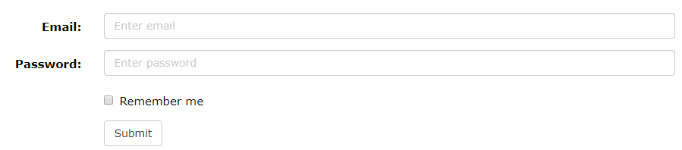
forms
Horizontal Form
  Labels are aligned next to the input field (horizontal) on large and medium screens. On small screens (767px and below), it will transform to a vertical form.

Slide 8
forms
Additional rules for a horizontal form:
    Add class .form-horizontal to the <form> element
    Add class .control-label to all <label> elements
Tip: Use Bootstrap's predefined grid classes to align labels and groups of form controls in a horizontal layout.

Slide 9
Form inputs
Supported form inputs / controls:
  Input, textarea, checkbox, radio, select
Input
  Bootstrap supports all the HTML5 input types:
    text, password, datetime, datetime-local, date, month, time, week, number, email, url, search, tel, and color.

Slide 10
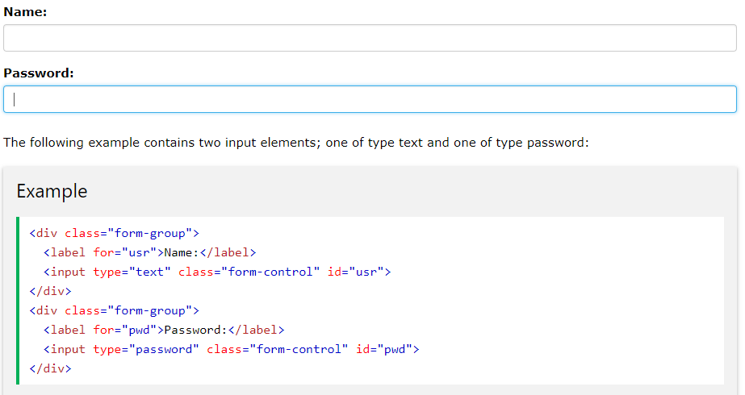
Form inputs
Example
NOTE: Inputs will NOT be fully styled if their type is not properly declared!

Slide 11

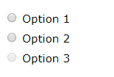
Form inputs
RadioButtons
  The following example contains three checkboxes. The last option is disabled:
.radio-inline
Default radio

Slide 12
Form inputs
As we have seen so far, the main rule of thumb for applying a bootstrap style on form inputs is add a class “.form-control” class when you declare it
Input Groups
  The .input-group class is a container to enhance an input by adding an icon, text or a button in front or behind it as a "help text".

Slide 13
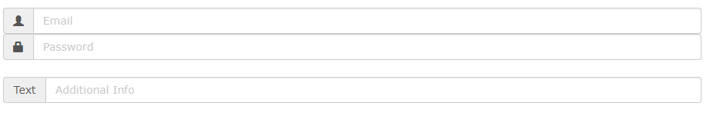
Form inputs
  The .input-group-addon class attaches an icon or help text next to the input field.

Slide 14
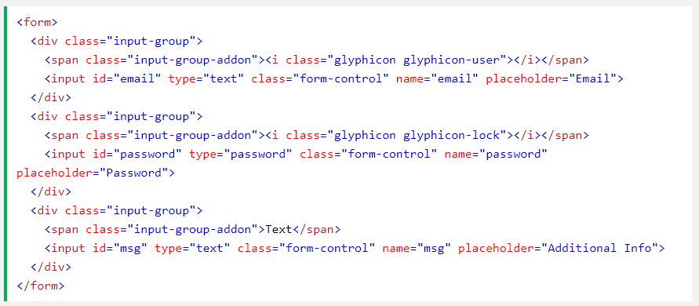
Form inputs

Slide 15
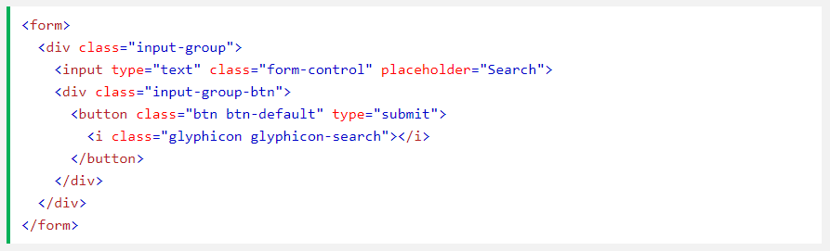
Form inputs
The .input-group-btn attaches a button next to an input. This is often used together with a search bar:

Slide 16
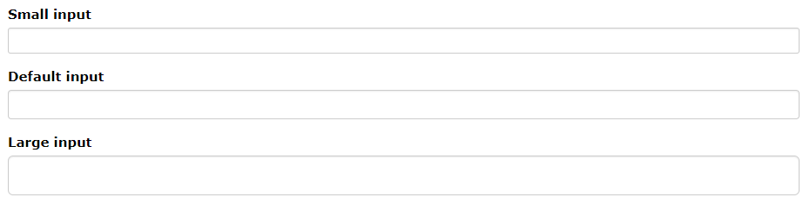
Form inputs
Input sizing
  Set the heights of input elements using classes like .input-lg and .input-sm.
  Set the widths of elements using grid column classes like .col-lg-*and .col-sm-*.
Height sizing

Slide 17
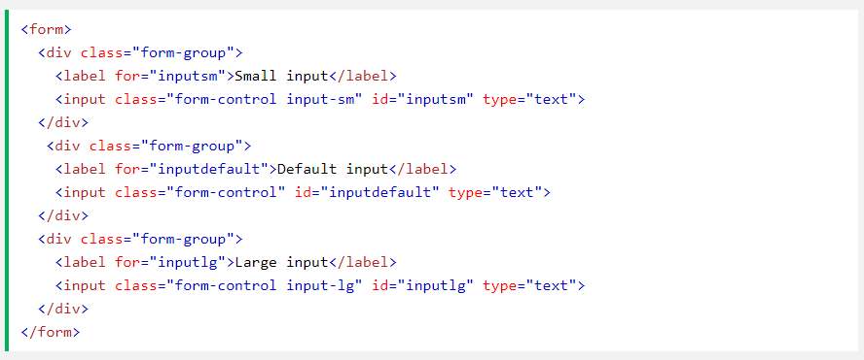
Form inputs
The following examples shows input elements with different heights:

Slide 18
Form inputs
You can quickly size labels and form controls within a Horizontal form by adding .form-group-* to the <div class="form-group"> element:
You can also quickly size all inputs and other elements inside an .input-group with the .input-group-sm or .input-group-lg classes:

Slide 19
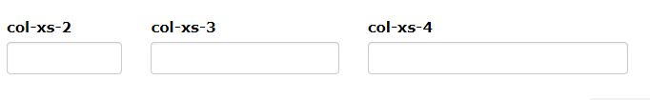

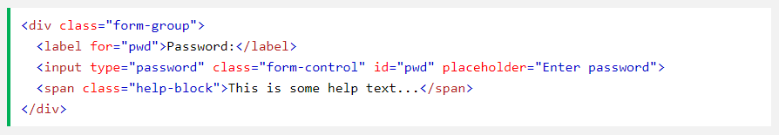
Form inputs
Column sizing:
Help Text:
  Use the .help-block class to add a block level help text in forms:

Slide 20
Thank You!

